Slide 1

Rent Spike Watch
Know the next spike

Slide 2
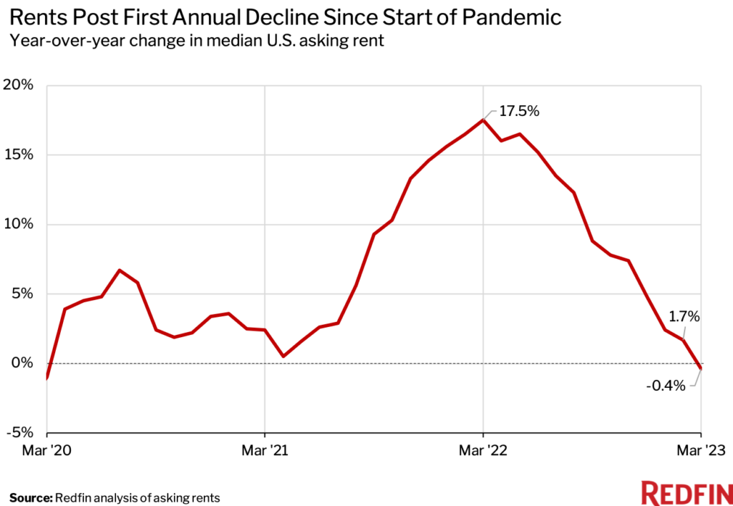
Current Situation

Slide 3
Problem
Rent prices spike on people with no warning
Why did they increase?
What are the biggest factors to increase in rents?
How do we budget for next year in this volatile market?

Slide 4
Rent Spike Watch
Know the next spike

Slide 5
Demo

Slide 6
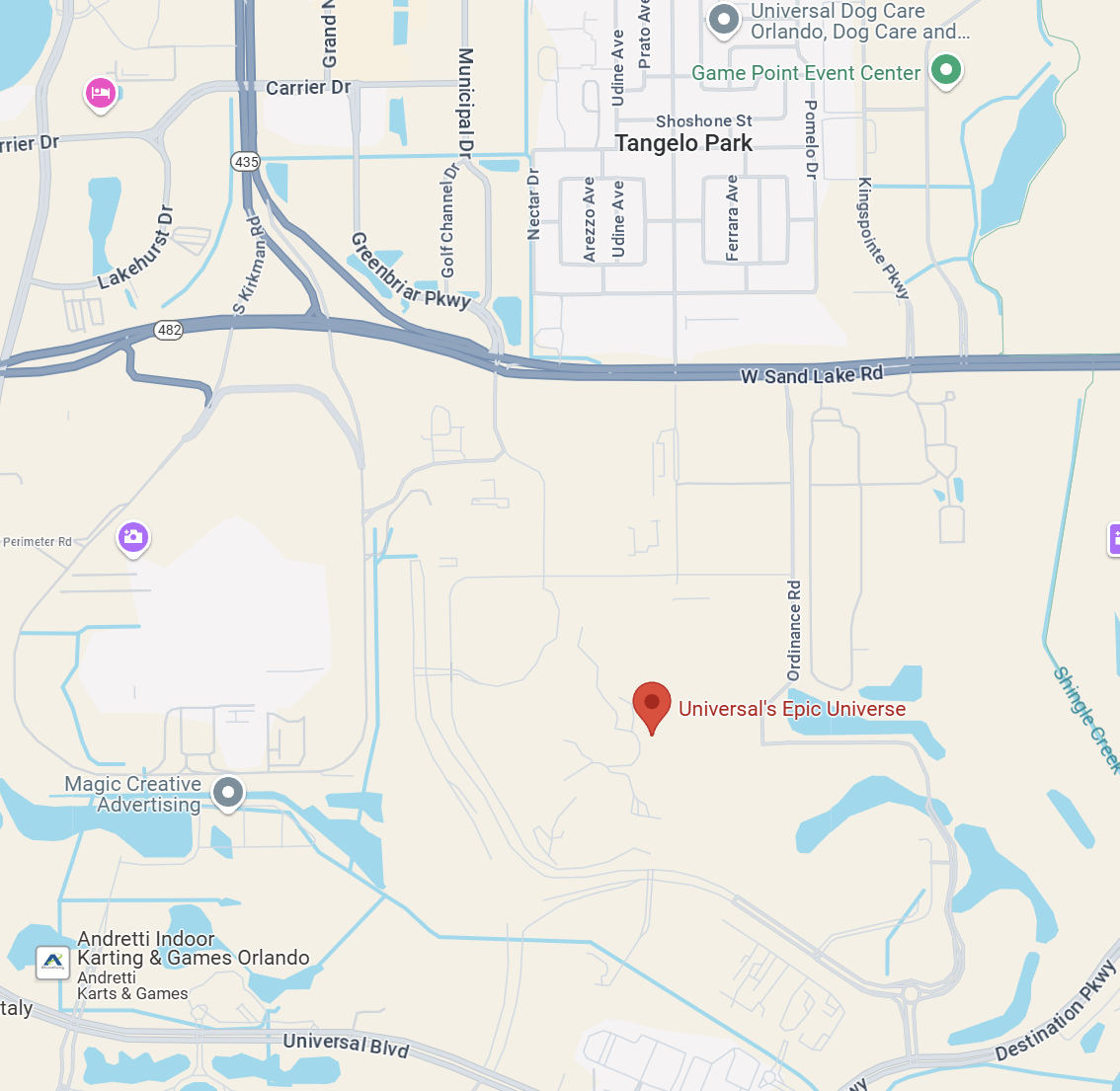

Demo

Slide 7
How we got there
Gather impact of construction
Web Scrape City and county’s construction info
Gather historical impact
Estimated price change

Slide 8
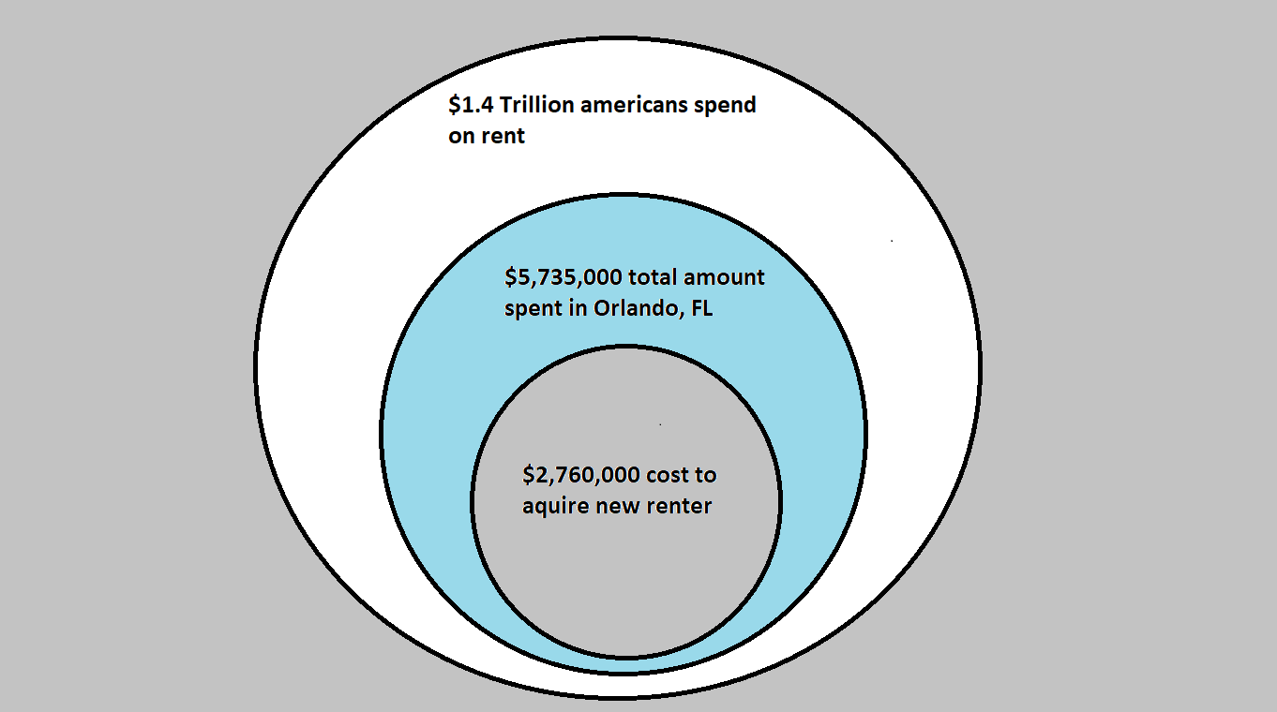
Demand
TAM
SAM
SOM

Slide 9
Business Plan
Premium Grade
Consumer Grade
Release free test pilot for highly changing regions (Orlando, Seattle, Austin)
Prices
Corporate version/contract
FREE
Shows the general increase for 1 year
Shows local construction and other factors
$20/month
Shows the estimated price for 5 years
Shows estimated impacts with exact diagnostics of increase

Slide 10
Project Timeline
Stage 1 - product design and prototyping
Stage 2 - verification and validation
Stage 3 - Pilot Release
3 month
3-6 month
6 month
Development Proposal
Development Planning
Concept Design (Input)
Design Development(Design Output)
Design verification
Contracting
Design Validation
Market Valuation
Registration
Design
Proposal
Timelines
Budgeting
Design Plan
Risk Management Plan
Specification
Early stage Prototype
Establish Contracts and potential investors
SEO
Interest Demo
Risk Management Report
Start campaign
Register as LLC
Mass Production

Slide 11
Potential Impact
Variance in annual budget
Savings In Acquiring a new rental unit
Saves time in waiting for a rental price drop

Slide 12
Rent Spike Watch
Know the next spike

Slide 13





Meet the team
Ernest Choi
Principal AI Consultant
Christopher Lubin
Sr Software Engineer
Tiffany Anglero
Frontend Developer
Kelsey Joseph
Embedded Software Engineer
Carlos Perez
Software Engineer

